Slide 1
Machine Learning for Modal Analysis
Vaibhav Malhotra
Supervisor: Dr Tore Butlin

Slide 2
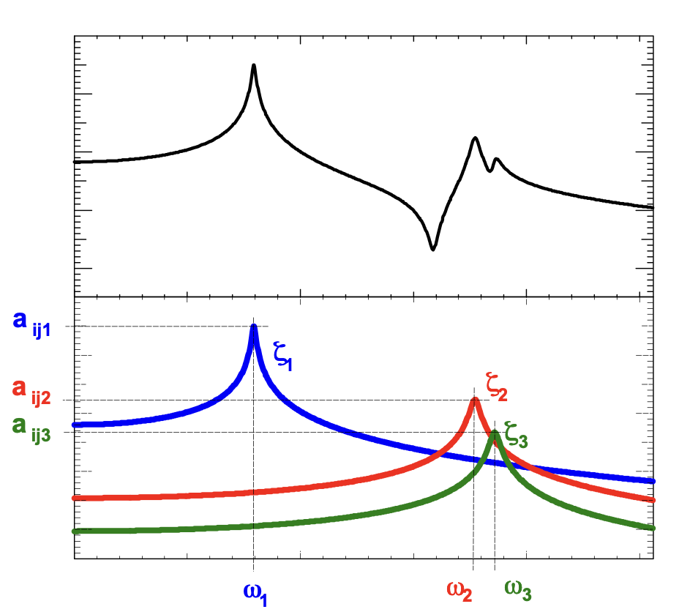
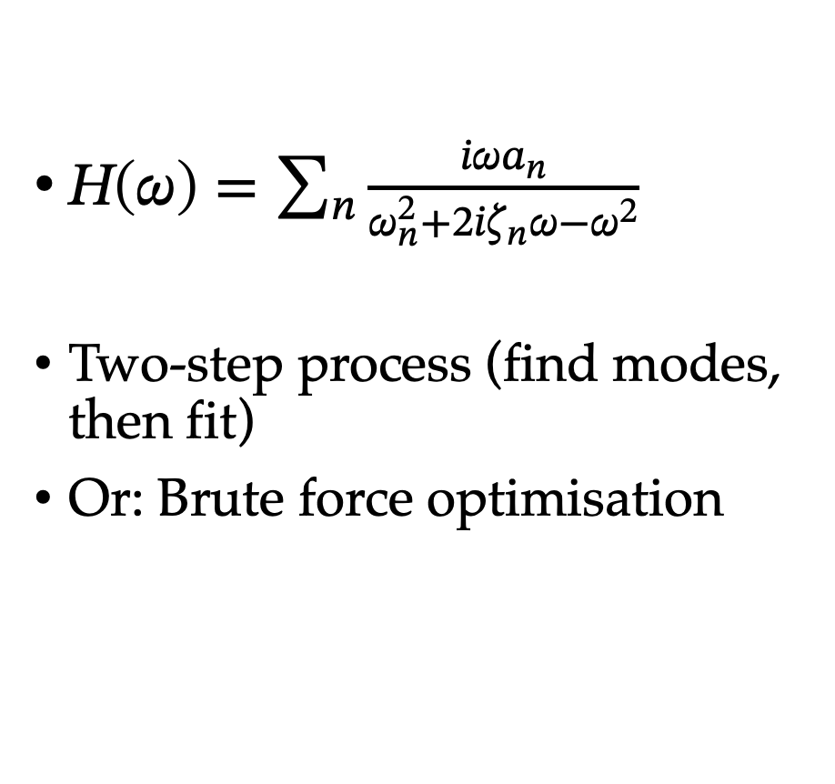
What is Modal Analysis?
$H\left(ω\right)=\sum_{n}{\frac{iωa_{n}}{ω_{n}^{2}+2iζ_{n}ω−ω^{2}}}$
Two-step process (find modes, then fit)
Or: Brute force optimisation
Image Reference: Avitabile, P., 2001. Experimental modal analysis. Sound and vibration, 35(1), pp.20-31.

Slide 3
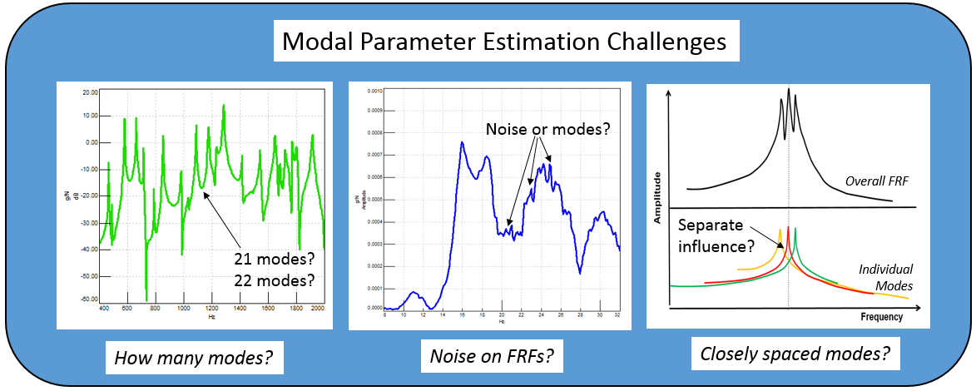
Project Motivation
Existing methods require expert knowledge or manual intervention
Want to remove subjectivity
Image Reference: https://community.sw.siemens.com/s/article/getting-started-with-modal-curvefitting
Notes:
Existing methods require lots of user intervention/ expert knowledge/ are computationally expensive
Sometimes even hard for a user to determine e.g. if many closely spaced modes, or if very noisy + existing methods can fail here
Previous approaches only give point estimates (no ‘true’ parameters – chosen model can only approximate true system behaviour)
Fully automated system, remove subjectivity and user intervention
Principled, probabilistic approach to the problem that gives parameter uncertainties

Slide 4
Project Structure
Identify and locate possible modes using ML
Generate ‘priors’ over modal parameters
Obtain probability distributions over modal parameters
Want a fully automatic system
Notes:
ML method + priors to replace expert knowledge and subjectivity in locating modes
Priors: rough regions in which we think the modal parameter values should lie
Incorporate the transfer function measurement information + compare with model
Uncertainties in parameters, no 'true' parameter settings

Slide 5
Training Data
Notes:
Train model using synthetic, representative TFs
Randomise natural freqs, damping ratios and modal amplitudes

Slide 6
Training Data
Notes:
Generate TFs with those random parameters
Label points as belonging to a mode if within the 3dB bandwidth of the mode, shown by the grey bars here

Slide 7
Model Performance
Notes:
Good performance, locate nearly all modes. Recognises bottom right as pure noise and does not predict any modes in the noise
Cant tell if there are multiple modes in a given region (cant predict modal overlap)

Slide 8
Extending the Model

Slide 9
Extending the Model
Notes:
Class 1: points belonging to a single mode, within 3dB bandwidth as before

Slide 10
Extending the Model

Slide 11

Obtaining the Posterior
Bayes’ theorem (Observed transfer function $x$, modal parameters $θ$):
$$p\left(θ | x\right) ∝p\left(θ\right)p\left(x | θ\right)$$
posterior $∝$ prior $×$ likelihood
Notes:
Likelihood: measure of error between true measurement and model output (as a function of the parameters)
Posterior: not simple to sample from (or obtain marginal distributions), use MCMC sampler
Posterior is a distribution over the parameters – gives uncertainties

Slide 12
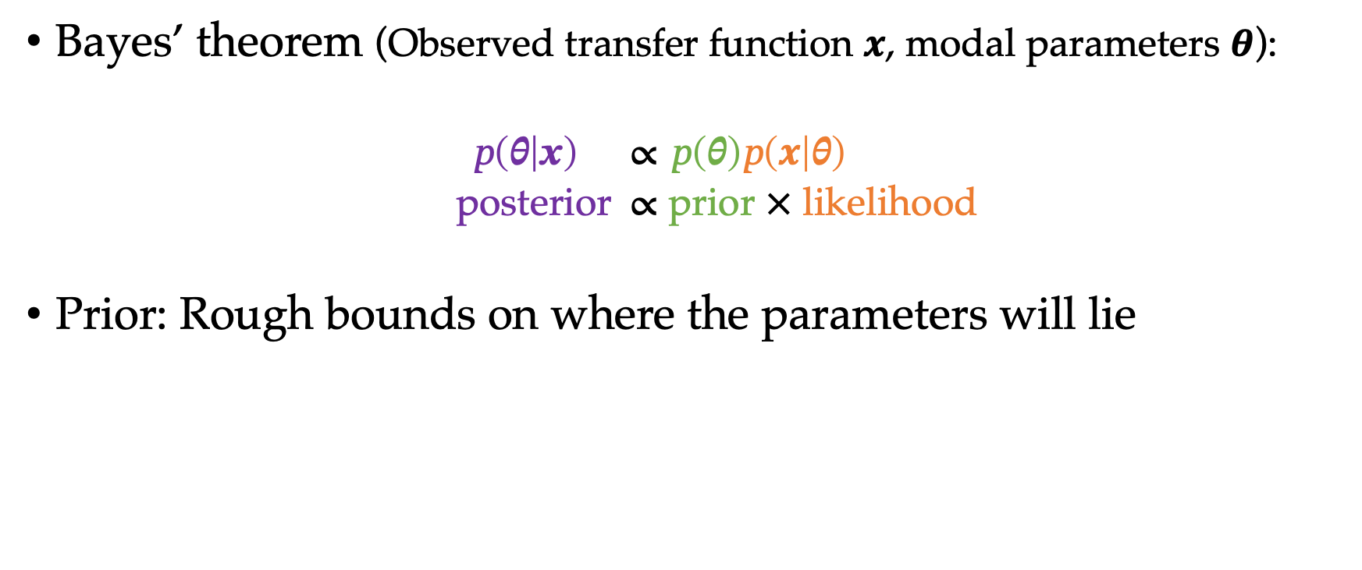
Obtaining the Posterior
Bayes’ theorem (Observed transfer function $x$, modal parameters $θ$):
$$p\left(θ | x\right) ∝p\left(θ\right)p\left(x | θ\right)$$
posterior $∝$ prior $×$ likelihood
Prior: Rough bounds on where the parameters will lie
Notes:
Likelihood: measure of error between true measurement and model output (as a function of the parameters)
Posterior: not simple to sample from (or obtain marginal distributions), use MCMC sampler
Posterior is a distribution over the parameters – gives uncertainties

Slide 13

Obtaining the Posterior
Bayes’ theorem (Observed transfer function $x$, modal parameters $θ$):
$$p\left(θ | x\right) ∝p\left(θ\right)p\left(x | θ\right)$$
posterior $∝$ prior $×$ likelihood
Prior: Rough bounds on where the parameters will lie
Likelihood: How probable the data is, given the parameters
Notes:
Likelihood: measure of error between true measurement and model output (as a function of the parameters)
Posterior: not simple to sample from (or obtain marginal distributions), use MCMC sampler
Posterior is a distribution over the parameters – gives uncertainties

Slide 14
3C6 Data
Notes:
parameter samples from posterior
red line shows 100 different transfer functions generated with sampled parameter settings from the posterior
all seem to overlap - expected, low uncertainty in modal parameters, low noise

Slide 15
4C6 Data
Notes:
When we sample from posterior, regions of high probability do not 'include' some of the 'modes' that the ML model has falsely identified. 'not include' meaning zero modal amplitude or large damping.
A bit more uncertain in parameter values

Slide 16
Entire 4C6 Data
Notes:
Doesnt perform as well in high noise region
Aim of making a fully automatic system has been achieved
This project provides a good framework on which future work can be built, final results quite promising

Slide 17
Thanks for Listening
Questions?

Slide 18
Architecture Details
Multi-layered bi-directional LSTM
LSTM cells instead of RNN cells

Slide 19
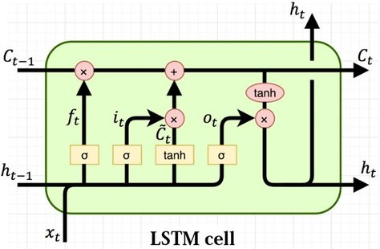
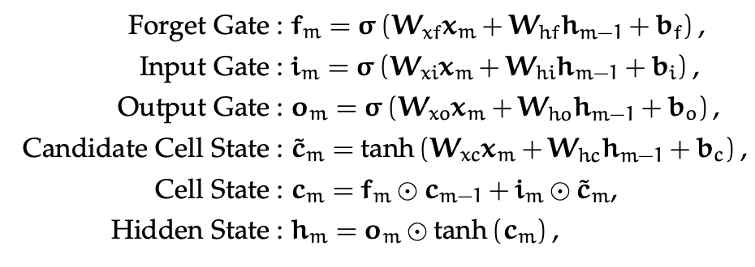

LSTM Cell Details
Cell state $c_{t}$(long-term memory), hidden state $h_{t}$ (short-term memory)
Forget gate $f_{t}$ (what percentage of long-term memory is remembered)
Input gate $i_{t}$ (how we should update the long-term memory with the candidate cell state)
Output gate $o_{t}$(determines new short-term memory based on current cell state)
Image Reference: https://www.researchgate.net/publication/329362532_Designing_neural_network_based_decoders_for_surface_codes/figures?lo=1

Slide 20
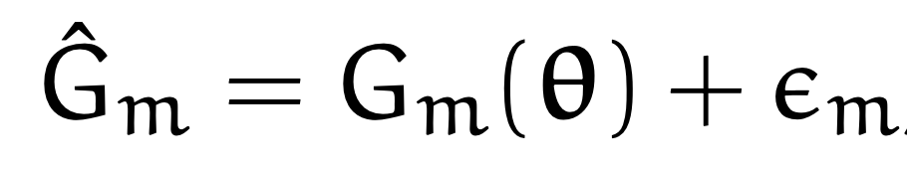
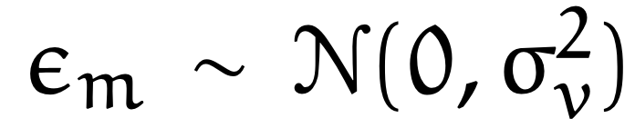
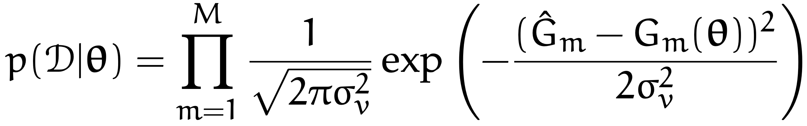

Likelihood
Frequency index $m$, model $G_{m}(θ)$, true measurements ${\hat{G}}_{m}$ (in dB)

